Slide 1
Grants vs Loans for
Employment and Microenterprise Development in Upper Egypt
ICRAC Conference: Dec. 5, 2019, AUC New Cairo
Dr. Mohamed El-Komi
The American University in Cairo, School of Business
Associate Professor of Economics and Director of BEDMLab (Behavioral & Economic Decision-Making Lab)
with
Dr. Bruno Crepon (CREST & J-PAL) and Dr. Adam Osman (University of Illinois Urbana Champagne & J-PAL)

Slide 2
Background
Youth unemployment in Egypt has been a growing problem, especially among women.
There is now a shift towards entrepreneurship as a way to enter and stay in the labor force.
This strategy is difficult to pursue for people coming from low-income families who may not have the ability to provide the money needed to start a business.
Youth then turn to microloans
Notes:
So Egypt, like many MENA countries has been suffering from a very high level of youth unemployment especially for women. Social norms and household responsibilities makes it difficult for many of them to be able to work outside of the home and/or for long hours
slides

Slide 3
What we do
Results from seven RCTs of microcredit programs across the world show no significant impact when it comes to business creation and increasing household income. On the other hand, returns to capital grants have been shown to be high in many developing countries.
These two seemingly opposing facts led to the design of a randomized evaluation that compares the impacts of providing loans vs cash grants vs in-kind grants.
Grants vs. Loans | Adam Osman (University of Illinois at Urbana Champaign)
Notes:
So in that context, we thought ok lets see the impact of loans on youth in Egypt, but given the literature that shows very modest impacts of loans on business development and some other that show positive impacts of grants, the next idea was to combine the two

Slide 4
Wide ranging implications
Helps us make sense of the modest impacts of microcredit:
  How do the returns of loans compare to the returns of capital in the same market?
Allows us to see if and how loans constrain investment decisions relative to cash grants
    Do unrestricted cash grants go to the highest return investments in the business?
    Does the rigidness of a loan actually force discipline and “good” behavior on the business owner?
Most cost-effective way of spurring enterprise development?
Grants vs. Loans | Adam Osman (University of Illinois at Urbana Champaign)
Notes:
Why we decided on that randomization? It could help answer many questions
Make sense of the small impacts of loans. As you all probably know there has been 7 RCTs on providing microloans that found no impact on business creation and profits so here we can look at the returns of loans compare to the returns of capital in the same market
Normally unrestricted cash is best for welfare, but that may not be what is best for the business
This would be by like saying eventually for example the cost of one grant is the same as 5 microloans and trying to see if the best thing is to just provide loans

Slide 5
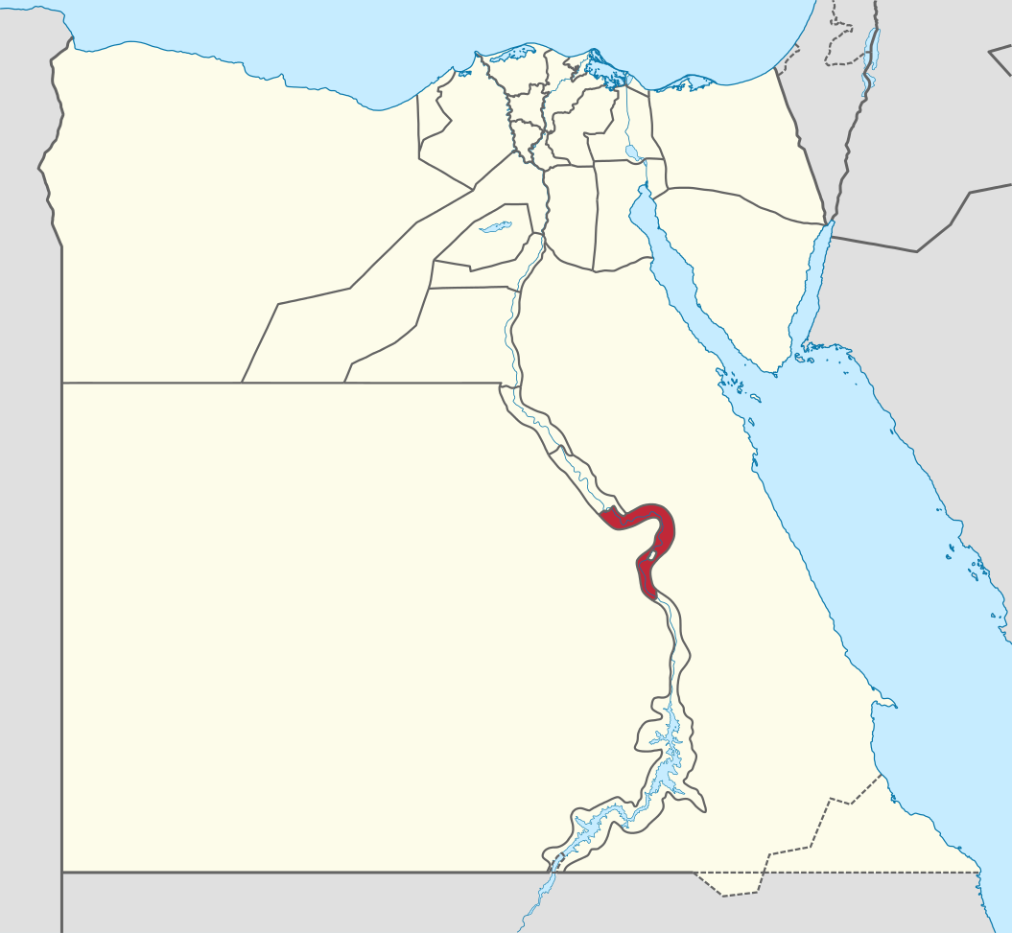
Local Context
Qena, Egypt:
  Population: 3 million
  Urbanization Rate: 20%
  3rd poorest of 27 governorates
  Part of a program funded by Sawiris Foundation
  Job Creation Competition between NGOs
  42 NGOs in “Upper Egypt” were funded
    3 NGOs, all in Qena, were chosen for this study
    4 other NGOs are part of a separate RCT focused on Job Training
Alexandria
Cairo
Qena
Grants vs. Loans | Adam Osman (University of Illinois at Urbana Champaign)

Slide 6
Experimental design
Eligible Loan Applicants
3294
Loan
1004 beneficiaries
Cash Grant
624 beneficiaries
In-Kind Grant
617 beneficiaries
Control Group
1049 beneficiaries

Slide 7
Experimental Design (cont.)
Loans and Grants averaged around 2300 EGP (~$140)
Approved applicants were randomized at the individual level into the 4 groups
  Loans: repayment between 10 and 12 months, nominal interest rate averaged 17%,
    Inflation rate was 23% due to surprise devaluation of currency
  Cash Grant: Told they don’t have to pay it back and can use however they want
  In-Kind Grant: Loan officers bought requested items with client
Grants vs. Loans | Adam Osman (University of Illinois at Urbana Champaign)
Notes:
55% were in retail, 29% in services, 11% agriculture, 3% manufacturing, 1% wholesale, 1% rounding

Slide 8
Experimental Procedures
We worked with three NGOs in Qena: Feda, Redec, Christian Peace from July 2016 until June 2019. (Baseline survey from June 2016 to July 2018, Endline survey from February 2018 to August 2019)
MFIs went into villages and offered individuals the opportunity to apply for a microloan over a 2-3 week period
Individuals would fill out an application with background information, requested loan amount, and reason for the loan
The loan conditions were explicit that it needed to be tied to a new or existing business
MFI would screen applicants and send us those they determined eligible
  Main eligibility criteria were age (18-34), and reasonable business plan
  Rolling program, implemented over a year, randomization by cohort
Grants vs. Loans | Adam Osman (University of Illinois at Urbana Champaign)
Notes:
Yeah so this is how the intervention went:
Main eligibility criteria was set by SFSD.
Everyone got a 2 day soft skills training. Some cohorts had vocational training. This was not randomized

Slide 9
Sample Characteristics & Balance
Comparison of Means of Observables Across Groups
 | (1) |  | (2) |  | (3) |  | (4)
 | Control Group |  | Loan |  | In-kind Grant |  | Cash Grant
Age | 28.9 |  | -0.394 |  | -0.386 |  | -0.324
Gender (Male) | 0.4 |  | 0.025 |  | 0.021 |  | -0.010
High School Education | 0.6 |  | 0.025 |  | 0.021 |  | -0.010
Worked Before | 0.3 |  | -0.009 |  | -0.003 |  | -0.004
Married | 0.6 |  | -0.012 |  | 0.015 |  | 0.015
Low Family Income | 0.7 |  | -0.011 |  | 0.027 |  | -0.023
P-Value for Joint Test |  |  | 0.255 |  | 0.604 |  | 0.302
Cohort Fixed Effects |  |  | Y |  | Y |  | Y
Observations | 1049 |  | 1004 |  | 617 |  | 624
Grants vs. Loans | Adam Osman (University of Illinois at Urbana Champaign)

Slide 10
Take Up of Capital Assistance
Grants vs. Loans | Adam Osman (University of Illinois at Urbana Champaign)
Notes:
This is also sort of an implementation check. So Take up was really high for the grant as opposed to 85% for the people in the loans group.
The loan amount is less because there are less people in the loan group
2% of the control group received loans from one of our implementing NGO

Slide 11
1 Year Follow Up
Grants vs. Loans | Adam Osman (University of Illinois at Urbana Champaign)
Notes:
Ok so results.
We finished endline data collection about 2 months ago. Where we were able to reach 95% of our sample
We see that all three types of financial support had economically large and statistically significant impacts on the proportion of people who have their own business.
On average the loan increases the proportion who have businesses from 20% to 34% and the grants increase this further to 39%.
The intent of the program was get people working so we also compare the proportion of people who are working at all (be it in their own business or working for others). We see that 50% of the people in control are working at all, while that increases to 60% for those that got the loan and to 64% for those that got the grants.

Slide 12
Heterogeneity: Why Gender?
The Middle East has one of the lowest levels of female labor force participation
Egypt is part of this trend with female LFP at 24% relative to 78% for men
Official unemployment is 25% for women relative to 8% for men
Gender plays a prominent role in social norms, anecdotally:
  Women are discouraged from pursuing work away from home, unless it is a government job
  Women are encouraged to get married early
  Women are discouraged from working after marriage
Grants vs. Loans | Adam Osman (University of Illinois at Urbana Champaign)
Notes:
We then estimate the impacts by gender and find striking differences

Slide 13
How Results Differ by Gender
Grants vs. Loans | Adam Osman (University of Illinois at Urbana Champaign)
Notes:
While both genders use the funds to increase business ownership
we see no impact on overall employment for men and huge increases in employment for women. This can be partially explained by the fact that 90% of men in the control group are working, while only 24% of women in the control are working. In the treatment groups about 90% of men are working (so no difference relative to control) but 39% of women in the loan group are working and 45% in the grants groups are working.
Weekly working hours, we also see a similar trend

Slide 14
Results: Capital Assistance increased income for women
Notes:
Total income= business profits + wage income + rent from assets + transfers from family members + government aid + other
Women are seeing significant increase in total income that is mainly driven by an increase in business profits compared to the women in the control
Following this we estimate the impacts of the treatments on total income and find no significant differences in income for men, but an increase of 17% for women in the loan group and an increase of between 27-36% in the grants groups. These increases are some of the largest that can be found in the development literature.
Aside from the men receiving loans having a significant increase in their business profits compared to the men in control, there is no impact on the men’s income

Slide 15
Results: Capital Assistance increased business ownership for men and women
Notes:
These results show that the impact of capital assistance on business ownership is much stronger on women than it is on men; women saw an average increase of 20 percentage points in business ownership between control and treatment, men saw an increase of 13 percentage points.
Many prior studies found that the impact of loans on business ownership is small and often indistinguishable from zero. In this setting we see large positive impacts.

Slide 16
Results: Capital Assistance increased total employment for women
Notes:
While the funding very positively affected women’s entry to the labor market it had no impact on men.
This means that while men will find work regardless of receiving assistance or not, women need support to help them enter the labor force

Slide 17
Results: Capital Assistance increased working hours for women
Notes:
Much like impact on work while the men see almost no impact on their weekly working hours, women are working much more.

Slide 18
Secondary End-line Results

Slide 19
Results: Capital Assistance decreased Women’s time spent on Household Chores
Notes:
Women on average spend most of their time at home between cooking and cleaning and childcare.

Slide 20
Results: Capital Assistance increased business assets for women
Notes:
Business assets is all assets bought during the year after the loan/grant was received
Assets include premise, land, furniture, equipment and machinery, vehicles

Slide 21
Results: Capital Assistance increased subjective wellbeing
Notes:
Women in the treatment groups think that they are doing well and are “happier” with their lives.
We also estimate the impacts these treatments have on other aspects of the lives of the participants.
One summary measure we use asks about life satisfaction by having people rate their life on a 10-point scale. While men’s life satisfaction increases by 5% on average, women who got a loan report a 10% increase in life satisfaction and a 15% increase for women who got the in-kind grant.
This was measured by asking participants to report on a scale, or “ladder steps”, from 1 to 10 which step they think they stand in terms of happiness with their current achievements in life.

Slide 22
Explaining These Impacts
Many other things could explain additional heterogeneity that may be hiding beneath the surface:
  Self-Control Problems
  Time Discounting
  Competitiveness
  Persistence
  Interest in Entrepreneurship
  Prior Business Experience
  Family Demands
  Risk Aversion
  Sunk-Cost Fallacy
  Human Capital
  Cognitive Ability
  Complimentary Financing
Grants vs. Loans | Adam Osman (University of Illinois at Urbana Champaign)

Slide 23
Summary of Results
We find that returns to grants and loans are positive relative to the control group, with lots of underlying heterogeneity
All three treatment groups lead to increases in business ownership, overall employment, business profits and total income
We find important differences by gender, with much stronger positive impacts for women, and many null effects for men, unlike most earlier studies
Explorations by individual attributes tease at other potentially important mechanisms
Grants vs. Loans | Adam Osman (University of Illinois at Urbana Champaign)

Slide 24
Conclusions
The impact of Capital Assistance is heterogeneous
Depends on local context
Outside option for women in Egypt much worse than for men (who are near full employment)
Access to capital greatly expands ability to work for women
Returns to capital are positive for both men and women
Longer term data would allow us to see how these businesses fare over time
Grants vs. Loans | Adam Osman (University of Illinois at Urbana Champaign)

Slide 25
Thank you

